Slide 1
Gravity The main engine for star formation
Patrick Hennebelle

Slide 2
Three simple facts about gravity
Jeans mass and length
Equilibrium solutions and stability
Collapse
Magnetized collapse and formation of discs

Slide 3
Three simple facts about gravity - 1
Gravity does not tend to produce sphere
Gravity amplifies anisotropies
=> gravitational force is the gradient of a potential
Gravity tends to produce filaments and sheets (Lin et al. 1965)

Slide 4
Three simple facts about gravity - 2
[G] = g⁻¹ m³ s⁻²
=> (ρG)^{-1/2} is a time
Shells of various density collapse in different times

Slide 5
Three simple facts about gravity - 2
More advanced
Consider a uniform sphere of mass M and a vanishing temperature.
Compute the acceleration of a shell (initial radius a):
All shells arrive at the same time in the centre.
The freefall time is not very different from:

Slide 6
Three simple facts about gravity - 3
Gravity tends to develop density powerlaw
Energy conservation:
Constant accretion rate:
Envelop dominates the mass
Central star dominates the mass

Slide 7
Three simple facts about gravity
Jeans mass and length
Equilibrium solutions and stability
Collapse
Magnetized collapse and formation of discs

Slide 8
Thermal energy
Consider a cloud of initial radius R and a constant temperature T
When R decreases, Etherm/Egrav decreases.
Thermal support decreases as collapse proceeds.
=>Any isothermal cloud, if sufficiently squeezed, will collapse.

Slide 9
The equations
(Spitzer 1978, Shu 1992)
Equation of state:
Heat Equation:
Continuity Equation:
Momentum Conservation:
Poisson Equation:

Slide 10
Gravitational Instability
(Jeans 02, Chandrasekar & Fermi 53, Ostriker 64, Spitzer 78, Larson 85, Curry 00, Nakamura et al 93, Nakamura & Nakano 78, Nigai et al. 98 , Fiege & Pudritz 00)
Consider (Jeans Analysis, 1902) the propagation of a sonic
wave in a plan-parallel uniform medium:
Continuity equation:
Conservation of momentum:
Poisson equation:
Dispersion relation:

Slide 11
Gravitational Instability
Dispersion relation:
if => sonic wave (modified by gravity)
whereas => there is an instability
means:
sonic propagation times smaller than the freefall time
Jeans Length: both decreases with density
Jeans mass: when the gas remains isothermal
Hoyle (1953): recursive fragmentation
As long as a cloud remains isothermal, it keeps fragmenting in smaller and smaller pieces
Large wavelengths grow more rapidly than small wavelengths (problematic for fragmentation)
For:

Slide 12
Gravitational Instability
Fastest growing mode is obtained for k=0
May mean no fragmentation but global collapse
There is however an issue with this calculation!
Do you see why?
is incorrect

Slide 13
Three simple facts about gravity
Jeans mass and length
Equilibrium solutions and stability
Collapse
Magnetized collapse and formation of discs

Slide 14
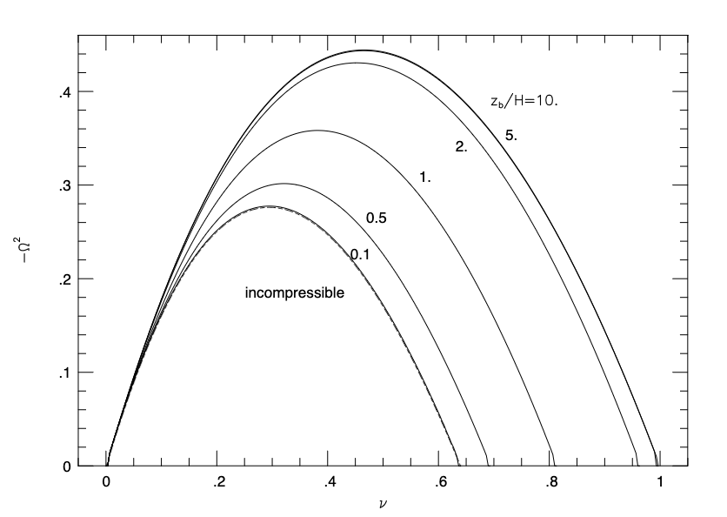
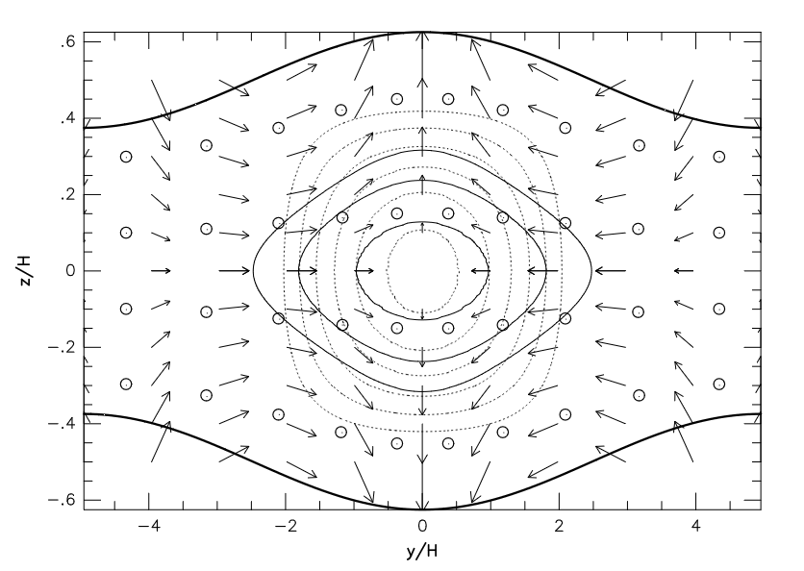
Self-gravitating sheet – equilibrium and stability
Linear stability of the self-gravitating sheet (Ledoux 1951, Spitzer 1978, Nagai et al. 1998)
idem: but for:
more unstable mode = typical width of the filaments :
Dispersion relation
Eigen mode – Sheet fragments in filament
Nagai et al. 1998

Slide 15
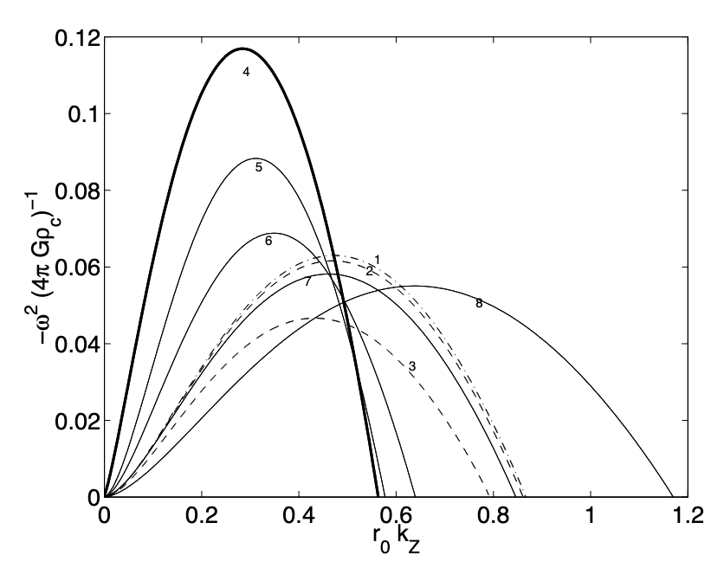
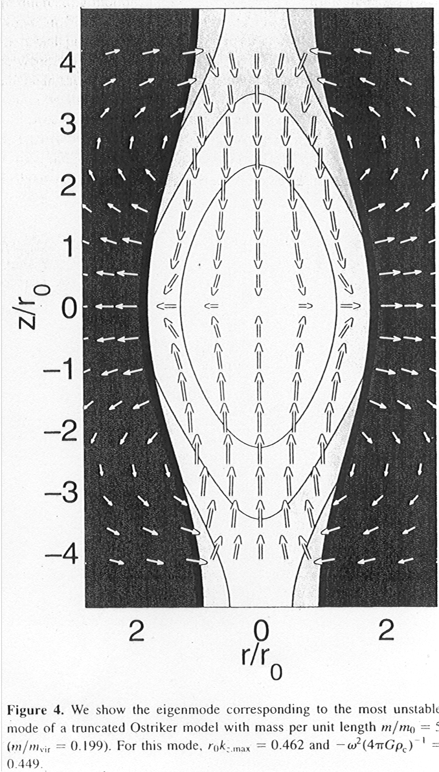
Self-gravitating filaments – equilibrium and stability
Self-gravitating filaments (Ostriker 1964)
-profile in 1/r⁴
as for the self-gravitating sheet there is a more unstable wavelength
Suggest: the dense cores are elongated structures with a spatial period close to the Jeans Length.
Dispersion relation
Development
of the gravitational
instability in a filament:
Formation of an
elongated core
Fiege & Pudritz 2000

Slide 16
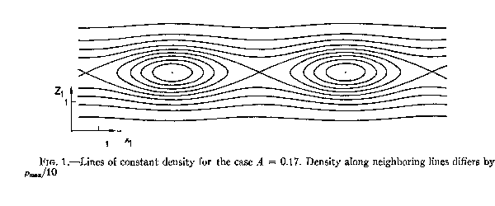
From self-gravitating sheet to self-gravitating filaments
Exact (fantastic) equilibrium solutions in 2D (Schmid-Burgk 1976) :
More advanced
Filaments
Fragmentation of a sheet into filaments

Slide 17
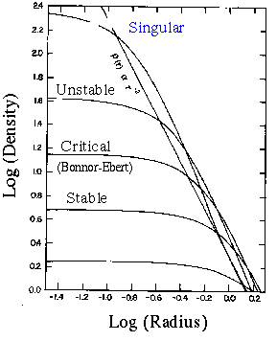
Spherical equilibrium solutions
(Bonnor 56, Ebert 55, Chandrasekhar, Mouschovias 77, Shu 77, Tomisaka et al. 85,
Li & Shu 98, Fiege & Pudritz 00, Galli et al. 01)
Bonnor-Ebert and Singular Isothermal Sphere (SIS):
Hydrostatic Equilibrium:
Asymptotically:
also exact solutions (SIS)
(notice the r⁻² again => coincidence)
Non singular Solutions:
truncated at the radius
stable only if:
Major role played by the external pressure!

Slide 18
Stability using the virial Theorem
(Shu 1992)
Using the Virial theorem, it is possible to have a hint of the hydro equilibrium
without solving the problem entirely.
Consider a cloud of radius R, mass M, temperature T.
Virial theorem:
leads to:
from which we get:
stability of the cloud requires:
There is a stable branch (weakly condensed clouds) and an unstable one (more condensed cloud).
More advanced

Slide 19
A major issue with « cores »
Isothermal self-gravitating equilibrium:
=> M(R) α R
Most of the mass is in the outskirt
But… there is NO well defined outskirt because no clear external pressure
When applying virial theorem for instance, the surface terms cannot be neglected.
The cores are not decoupled from their environment.

Slide 20
Three simple facts about gravity
Jeans mass and length
Equilibrium solutions and stability
Collapse
Magnetized collapse and formation of discs

Slide 21
Self-similar collapsing models
(Larson 69, Penston 69, Shu 77, Hunter 77, Bouquet et al. 85, Whitworth &Summer 85)
(analytical models are very important to understand the physics
and to validate the numerical methods. They present different
biaised and are complementary)
Self-similar Formalism
The fields a time t are proportional to their value at t=0.
Means that the initial conditions have been « forgotten ».
Spherical Collapse without rotation and magnetic field.
=>2 ordinary differential equations easy to solve!

Slide 22
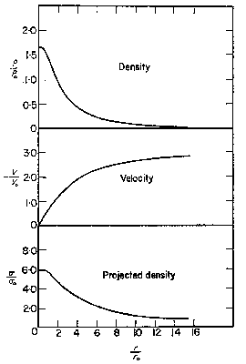
Larson-Penston solution (69):
at t < 0 :
-the central density is rather «flat » the velocity not far from homologous
-at infinity (supersonic part) the density is about 4 times the density of the SIS and the velocity is
supersonic (3.3 Cs).
Describes a very dynamical collapse induced by a strong external compression.
at t > 0 :
accretion onto the singularity with an
accretion rate of about:

Slide 23
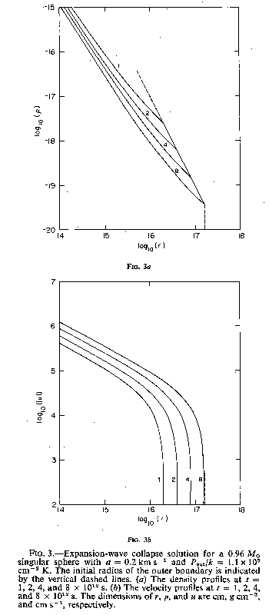
Shu Solution (77)
-make the assumption that the
prestellar phase is quasi-static
(eg slow contraction due to ambipolar
diffusion)
-at t=0 the velocity vanishes and the
density is the SIS
-at t>0 a rarefaction wave is launched
and propagates outwards:
inside-out collapse
The collapse starts in the centre
and propagates to the whole at the
sound speed.
Accretion rate:
Density
Radius
Velocity
Radius
Shu 77

Slide 24
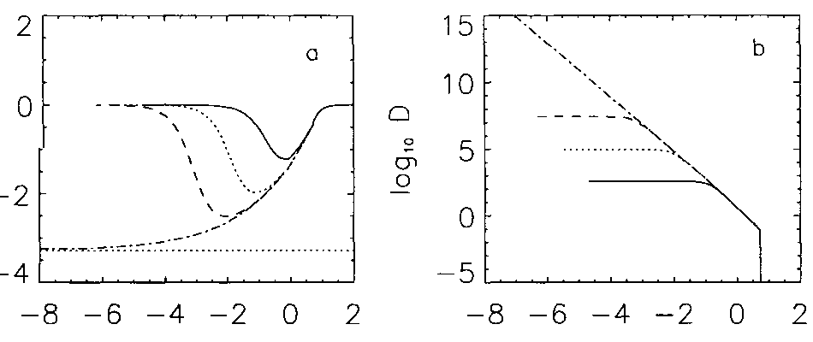
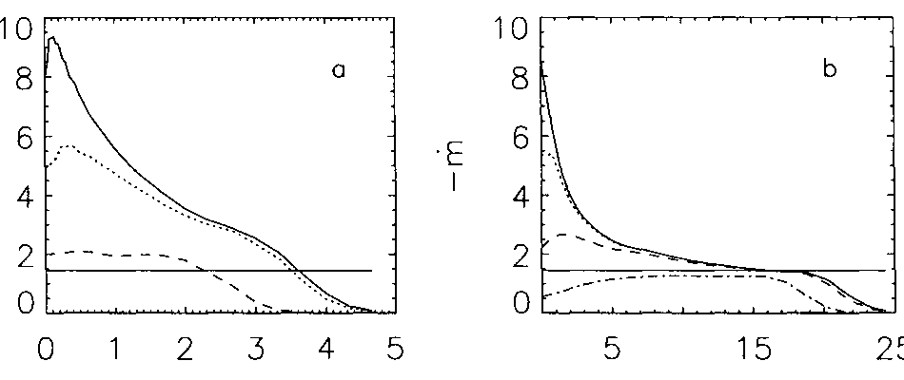
Gravitational Collapse: numerical models
Collapse of a critical Bonnor-Ebert sphere:
(Foster &Chevalier 93, Ogino et al. 99, H et al. 03)
initial condition:
Unstable Bonnor-Ebert sphere near the
critical limit
In the internal region the numerical solution
Converges towards the Larson-Penston
solution.
In the external part, the collapse is well
described by the Shu solution for the density
but the velocity does not vanish.
Accretion rate varies with time and reaches
about
Velocity
Density
Radius
Radius
Accretion rate
time
time

Slide 25
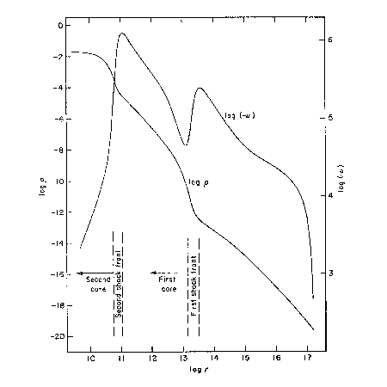
Formation of the protostar: the second collapse
(Larson 69, Tohline 82, Masunaga & Inutsuka 02,
Vaytet+2017, 2018, Bandhare+2020, Ahmad+2023)
Larson 1969
-ρ < 10⁻¹³ g cm⁻³ :
nearly isothermal
Accretion shocks
- 10⁻¹³ g cm⁻³< ρ < 10⁻⁸ g cm⁻³ :
adiabatic phase (first Larson core)
The core is in hydrostatic equilibrium
(Effective γ = 5/3 – 5/4). Its mass grows by accretion.
velocity
- 10⁻⁸ g cm⁻³< ρ < 10⁻³ g cm⁻³ :
dissociation of the molecular hydrogen. The gravitational
energy is used to dissociate H₂ (Saumon et al. 95) and not to heat the gas. Temperature stays nearly constant to 2000K.
The thermal support (Effective γ = 1.1) is not strong
enough and the collapse restarts.
Density
- ρ > 10⁻³ g cm⁻³: all hydrogen molecules have been dissociated
=>the gas becomes adiabatic,
=>Formation of the protostar

Slide 26
Three simple facts about gravity
Jeans mass and length
Equilibrium solutions and stability
Collapse
Magnetized collapse and formation of discs

Slide 27
Thermal Support
Consider a cloud of initial radius R
If γ<4/3, when R decreases, Etherm/Egrav
decreases:
Centrifugal Support and Angular Momentum Conservation
When R decreases, Erot/Egrav increases:
Magnetic Support and Flux Conservation
When R decreases, Emag/Egrav is constant:
Typically one infers μ=(M/φ)/(M/φ)_{c}=1-4
(Crutcher et al. 1999, 2004)

Slide 28
Angular momentum equation
More advanced
We need an equation to describe how angular momentum is transported.
Let us start with the azimuthal component of Euler equation.
Let us multiply it by r and combine it with continuity equation, we can show that
Angular momentum can be transported radially by a flux of matter.
Introducing the Lorentz force, it can be shown (using divB=0) that

Slide 29
Angular momentum equation
More advanced
Now let us consider gravity.
From which we finally get
Note the symmetry between g and B

Slide 30
Zoom into the central part of a collapse calculation
~30 light hours
XY
hydro
XY
MHD
μ=2
B, ω
XZ
hydro
XZ
MHD
μ=2
B, ω

Slide 31
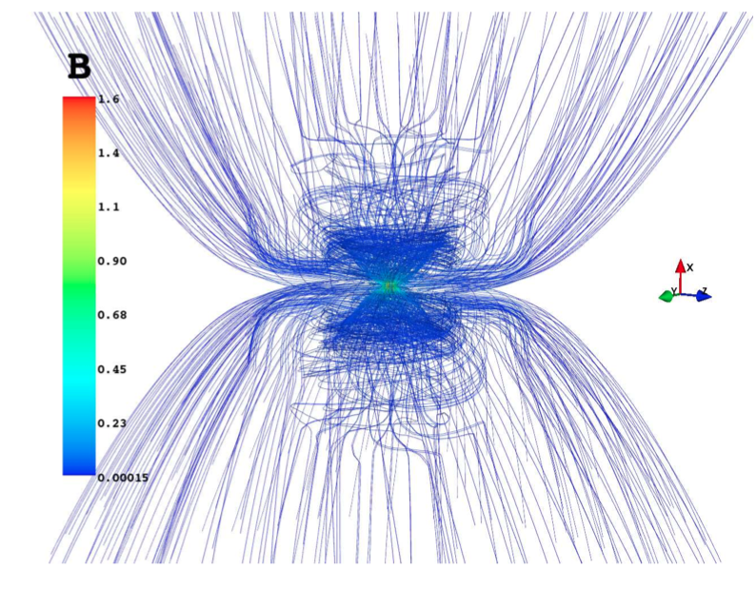
H&Fromang 2008, Padovani+2013

Slide 32
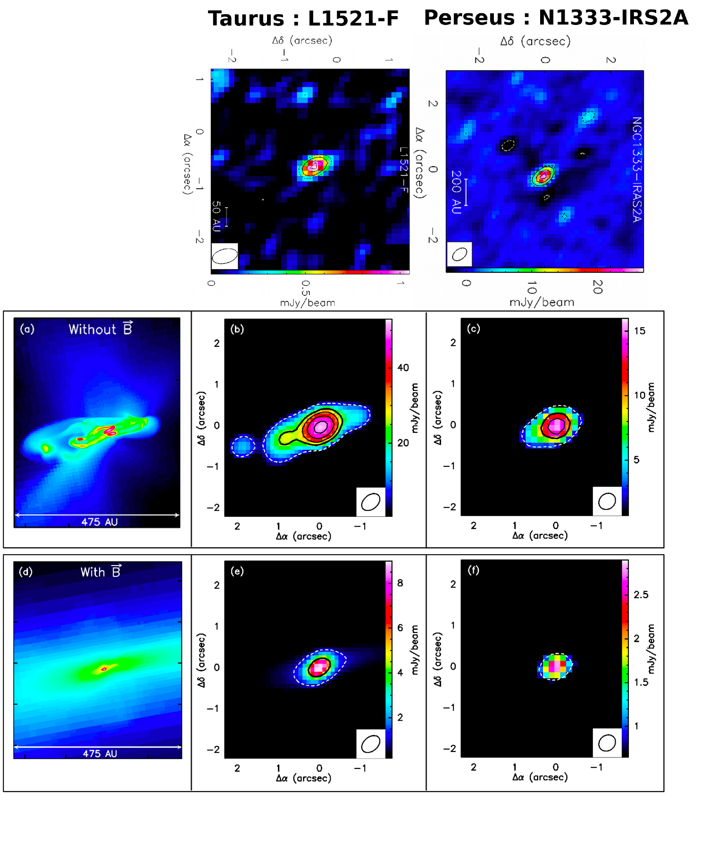
Comparison of the PdBI maps with MHD simulations
Hydrodynamical simulations
produce too much extended (+ multiple) structures if compared
to Maury et al. 2010
Observations.
MHD simulations ?
MHD simulations :
produce PdB-A
synthetic images with
typical FWHM ~ 0.2’’ - 0.6’’
Similar to Class 0 PdB-A sources observed !
need B to produce compact,
single PdB-A sources.
Taurus
Perseus
Maury et al. 2010

Slide 33
Conclusion
Important to combine series of approaches from the simplest to the more complex
Gravity in itself presents a rich dynamic that probably explain ISM feature such as the formation of filaments and the development of r⁻² powerlaws.
Needs however to be combined with support, such as thermal pressure, to predict the detail of fragmentation for instance.
Isothermal support does not lead to well defined objects…

